Slide 1
What is Android?
Mobile App Programming

Slide 2
Introduction to Android

Slide 3

Android is..
A mobile operating system developed by Google
Based on a modified version of the Linux kernel and other open source softwares.
Designed primarily for touchscreen mobile devices such as smartphones and tablets.
Further developed for Android TV, Android Auto, and Android Wear
Executing an application written in Java or Kotlin programming language

Slide 4
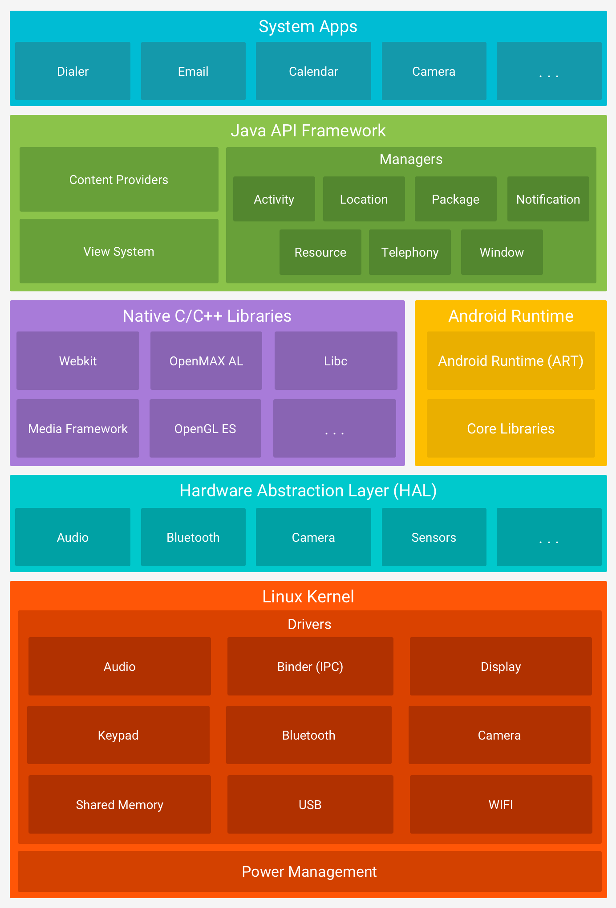
Android Platform Architecture

Slide 5
Glossary of Android
Activity
A single user-based task, usually, but not always, containing views
Content Provider
A component that serves data to other application
Broadcast receiver
Component receiving notifications from other activities
Service
Background process responding local or remote application requests

Slide 6
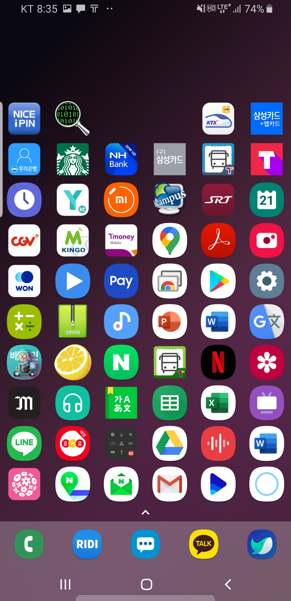
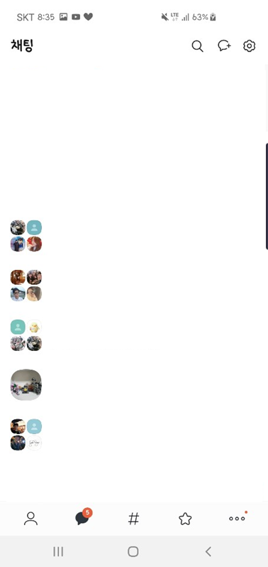
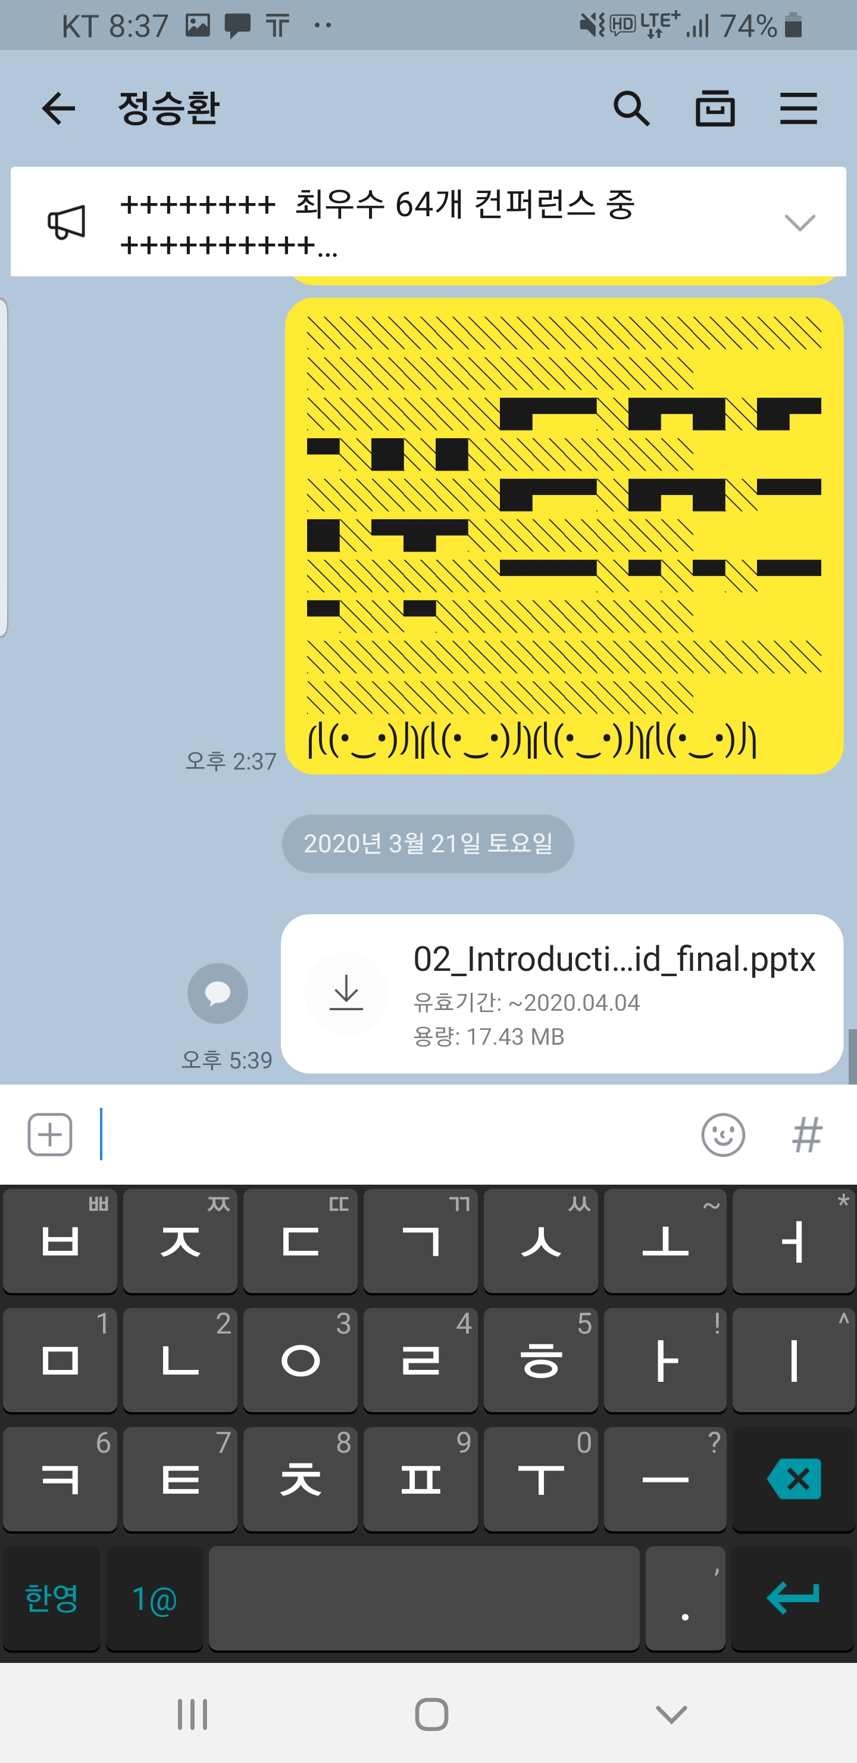
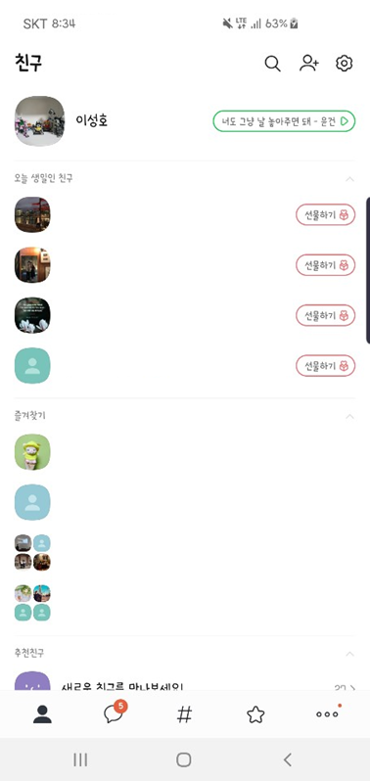
Glossary of Android - Activity
When you want to chat with friend…
정승환
Activity1
Activity2
Click Icon at Home
Click your friend tab

Slide 7
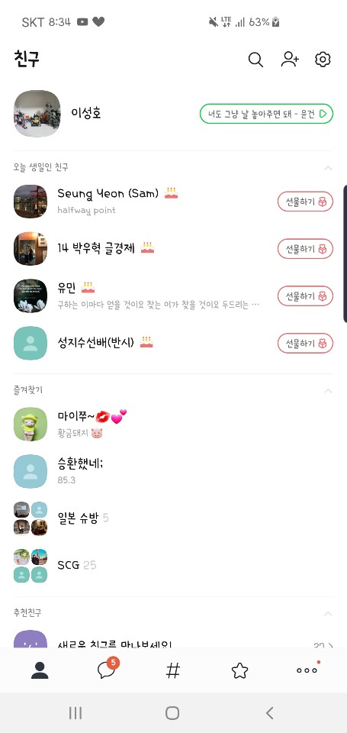
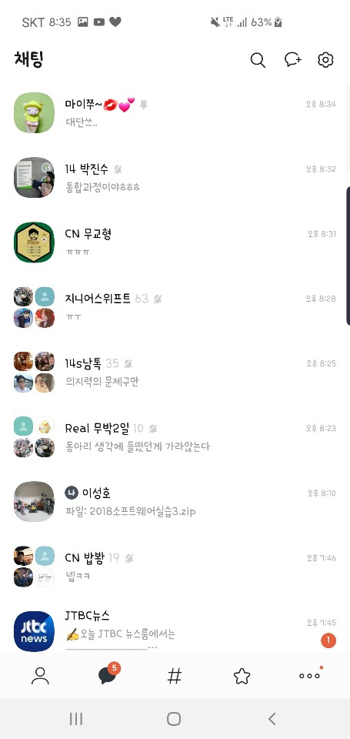
Glossary of Android - Activity
Basic Unit of android apps.
Views
Activity
Activity

Slide 8
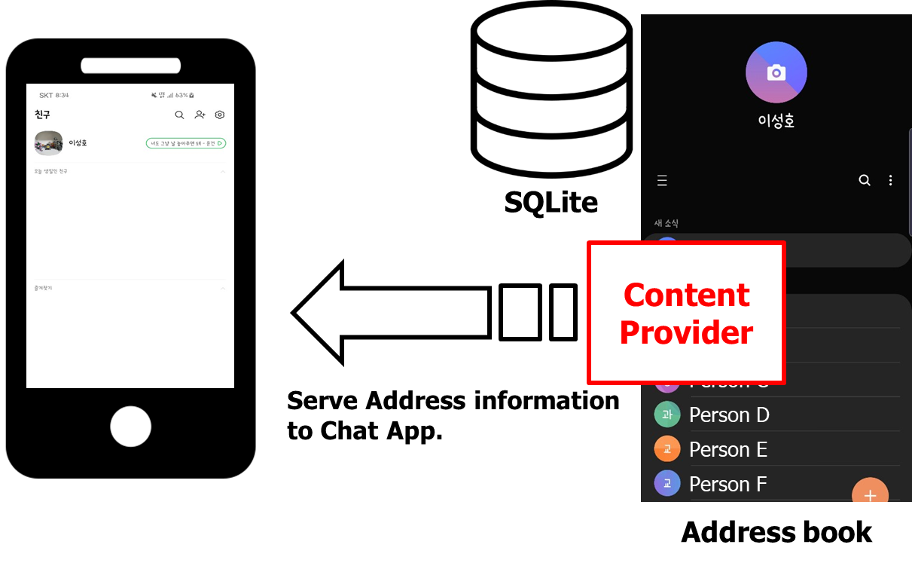
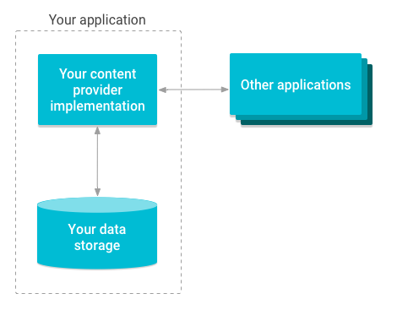
Glossary of Android - Content Provider

Slide 9


Glossary of Android - Broadcast Receiver
Broadcast
Receiver
Broadcast
“missed call information”

Slide 10

Glossary of Android - Component
Component
Activities, content providers, broadcast receivers, and services that together make up an application
Activities
Service
Broadcast Receiver
Content
Provider

Slide 11
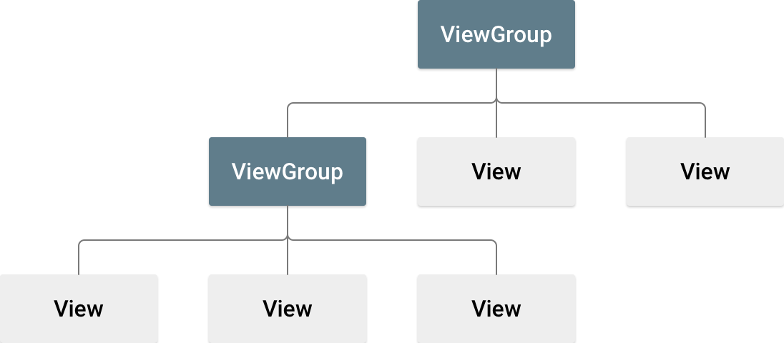
Glossary of Android
Layout
Visual arrangement of containers and views
View & View group
Base class for most layout components
Layout

Slide 12
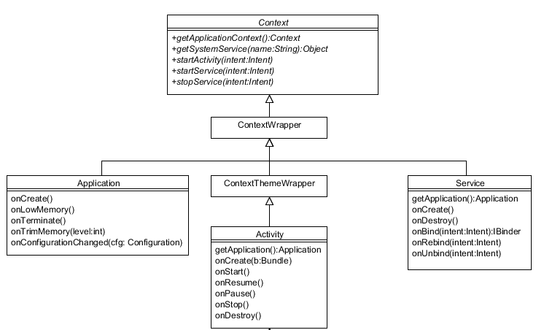
Glossary of Android
Context
Object containing the global state of an application environment

Slide 13
Glossary of Android
OnClickListener
OnLongClickListener
…
Text View
Buttons
ListViewAdapter
OnClickListener
OnLongClickListener
…
List View
UI Contents
Activity
(Arranged by Layout)
Context

Slide 14
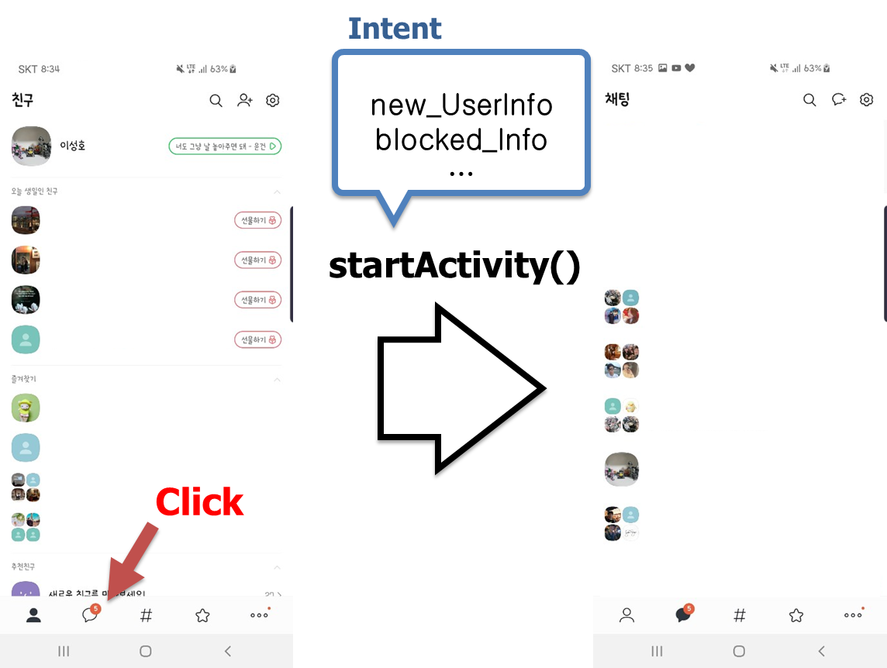
Glossary of Android - Intent
Intent
A messaging object to request an action from another app component. (ex. Message to start next activity)

Slide 15
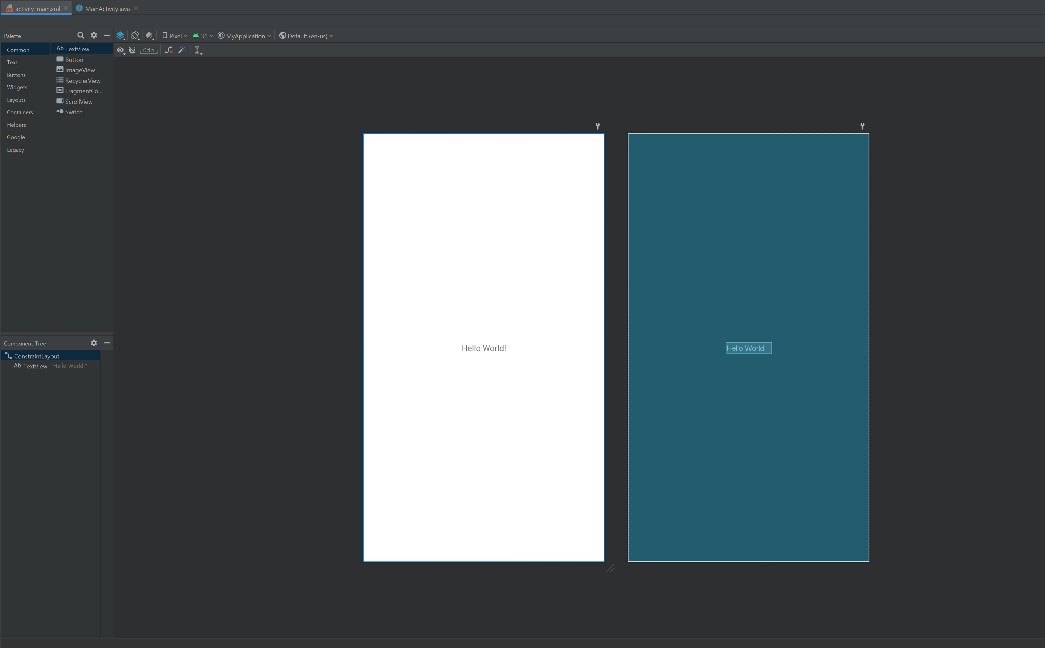
Put basic views into your project
How to put new UI contents (Views)
Drag & Drop
to put elements (Views, Layouts)

Slide 16
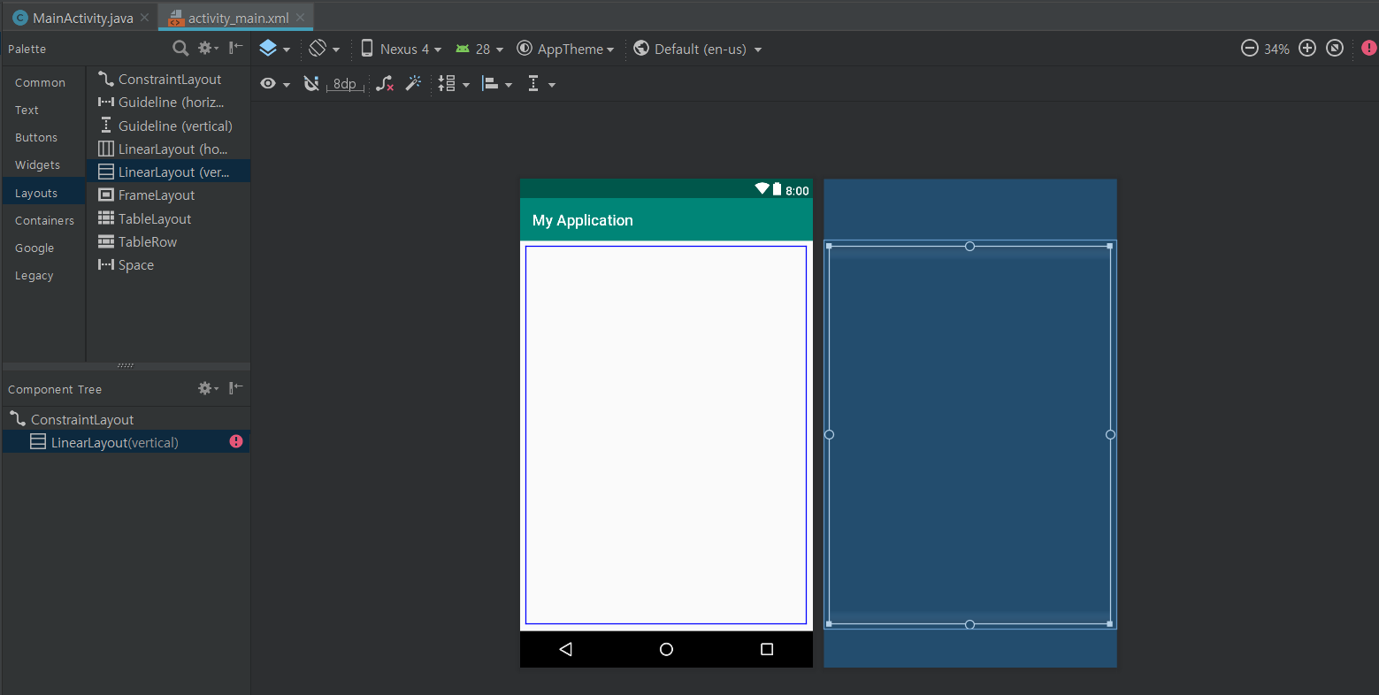
Put basic views into your project
Put linear layout (vertical)

Slide 17
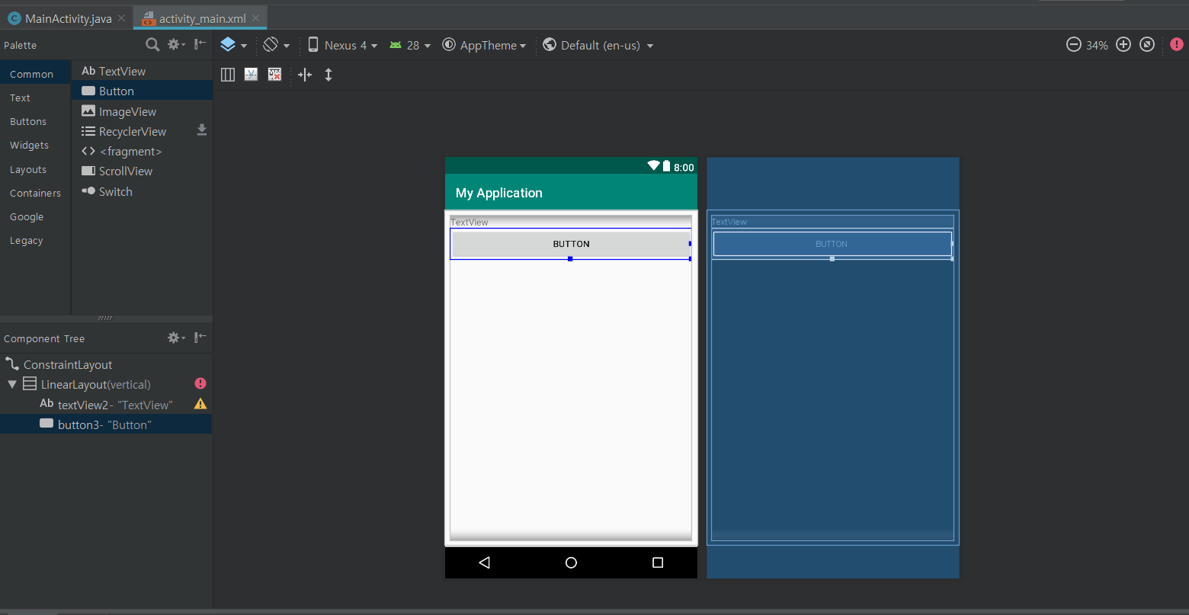
Put basic views into your project
2. Insert TextView and Button into linear layout.

Slide 18
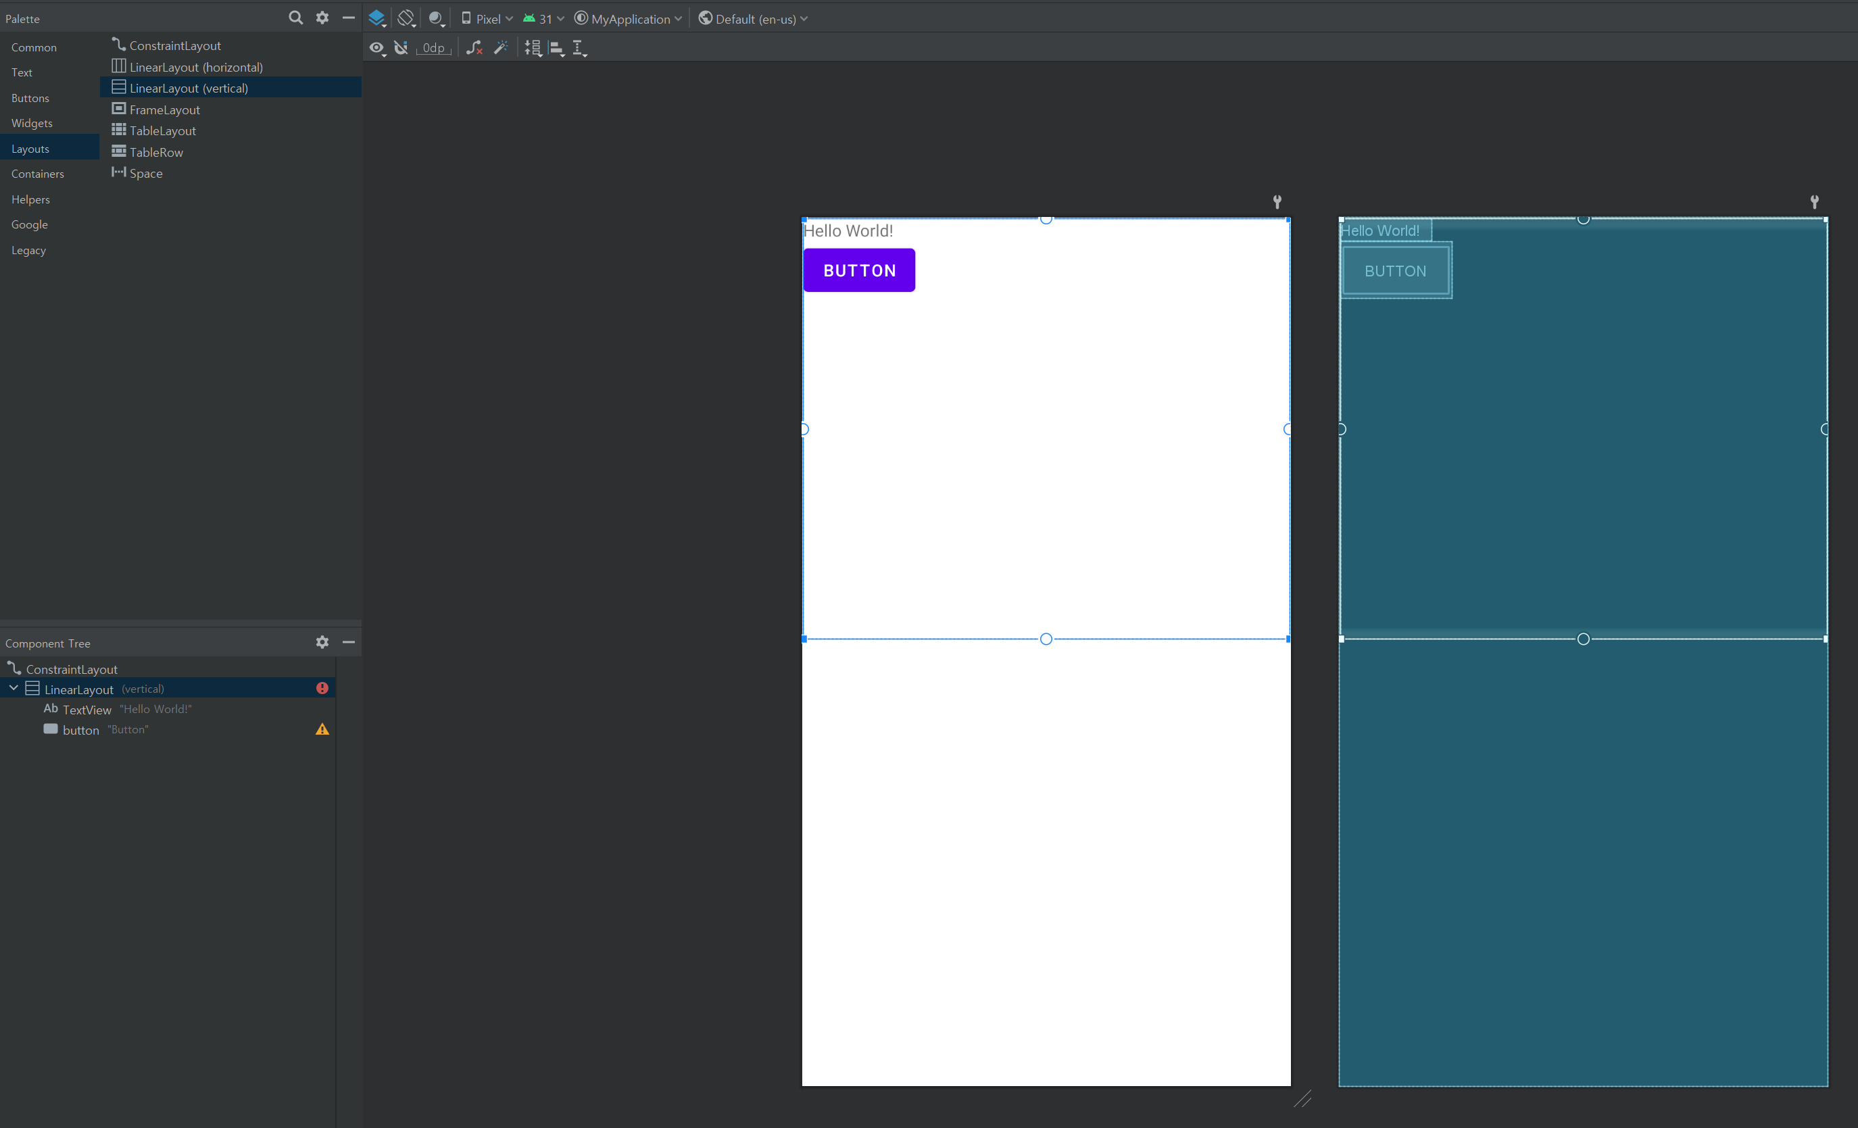
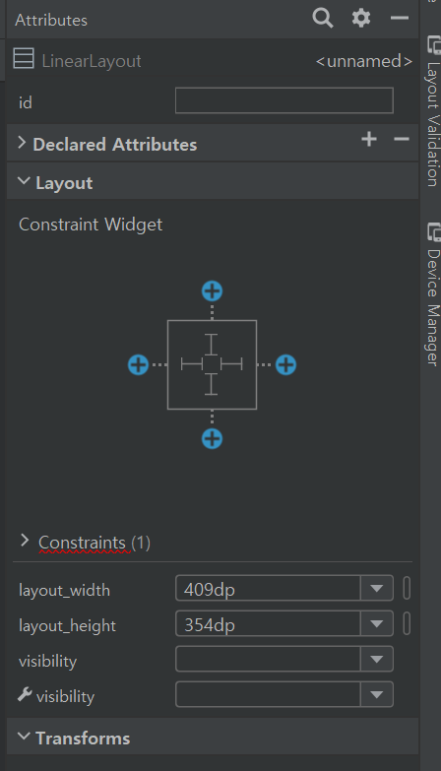
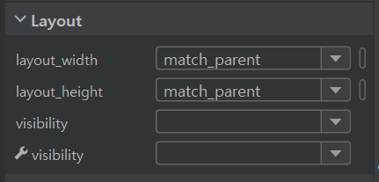
Put basic views into your project
How to put new UI contents (Views)
! Change it to

Slide 19
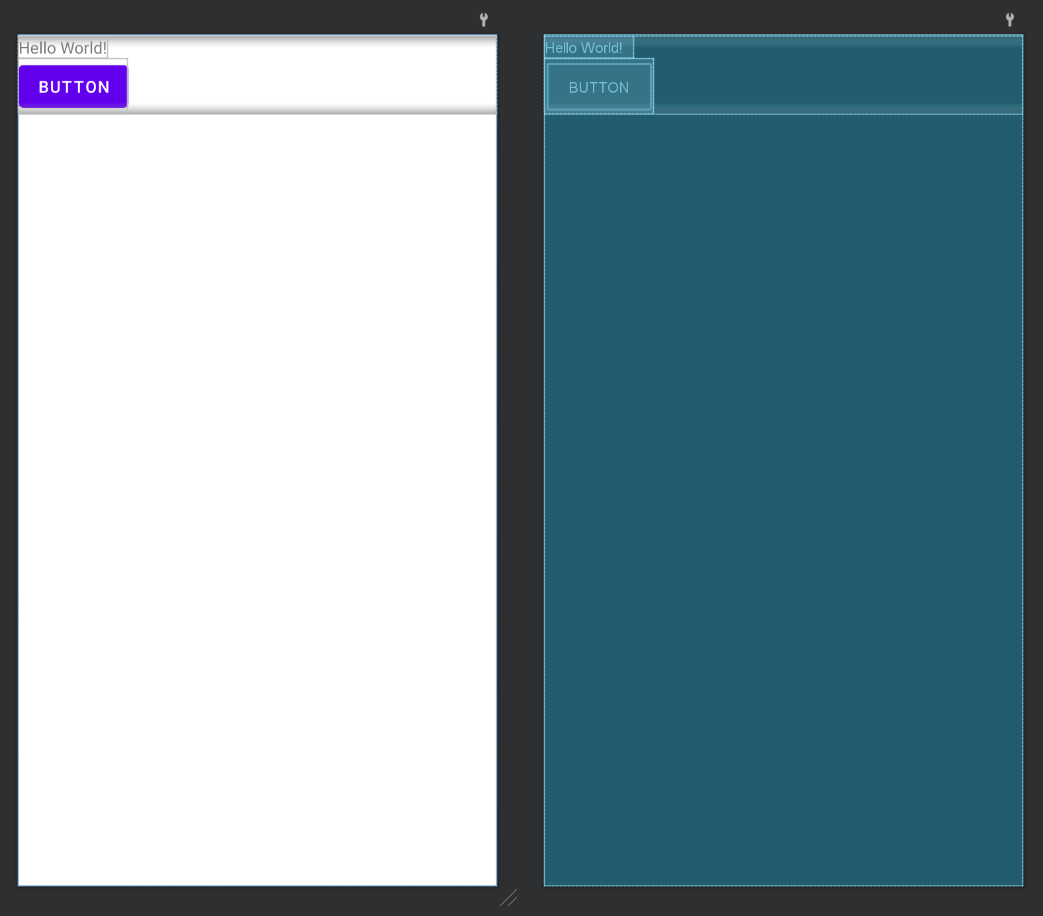
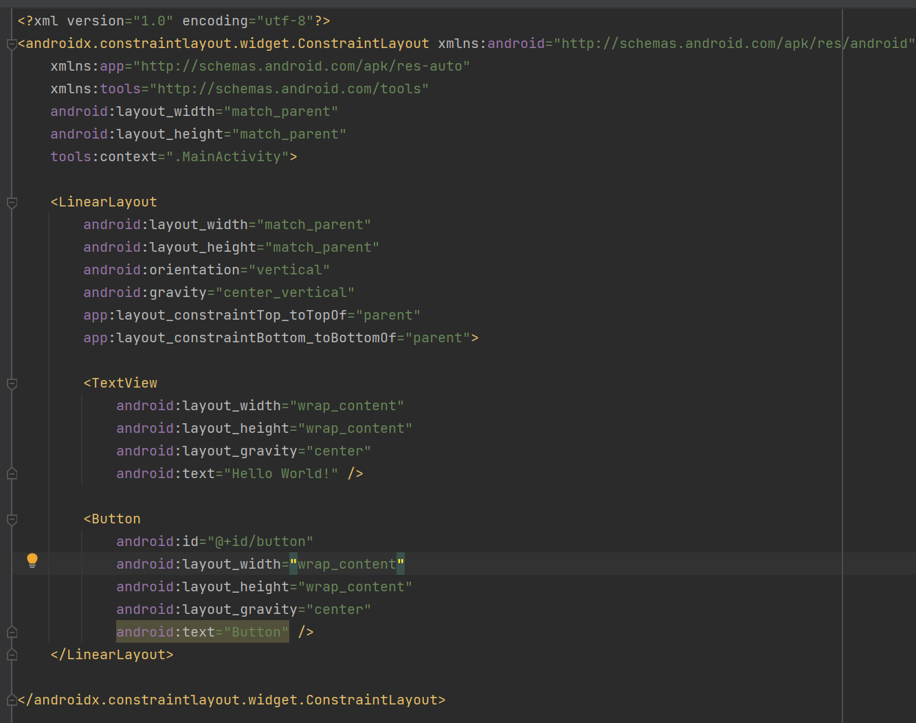
Put basic views into your project
How to put new UI contents (Views)
* There can be other ways to align the views in the center of screen.
! Change xml code like this:
match_parent
match_parent

Slide 20
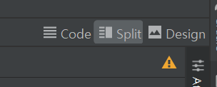
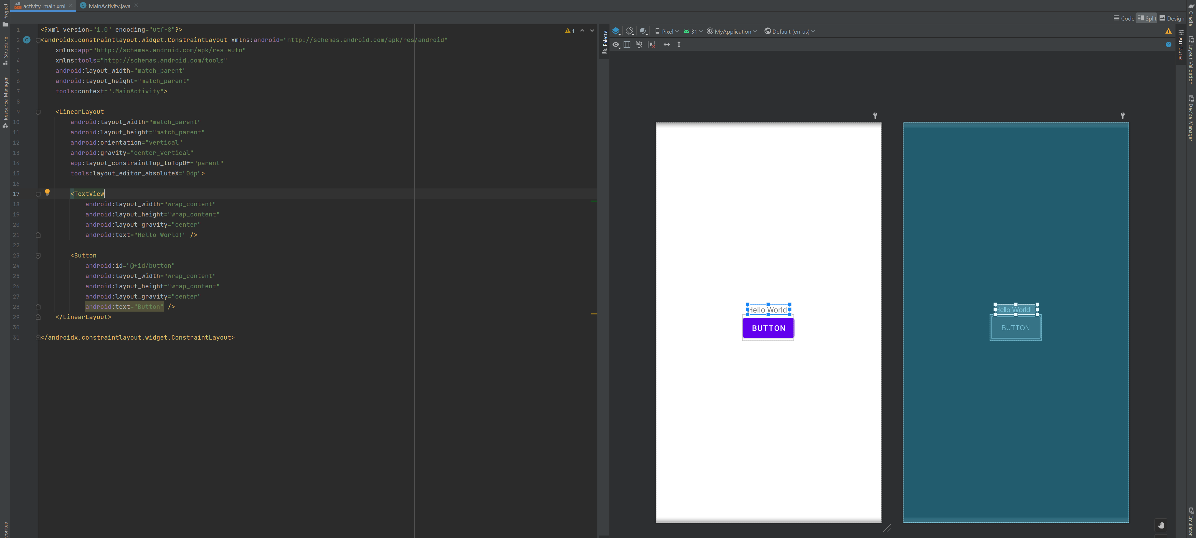
Put basic views into your project
How to put new UI contents (Views)

Slide 21
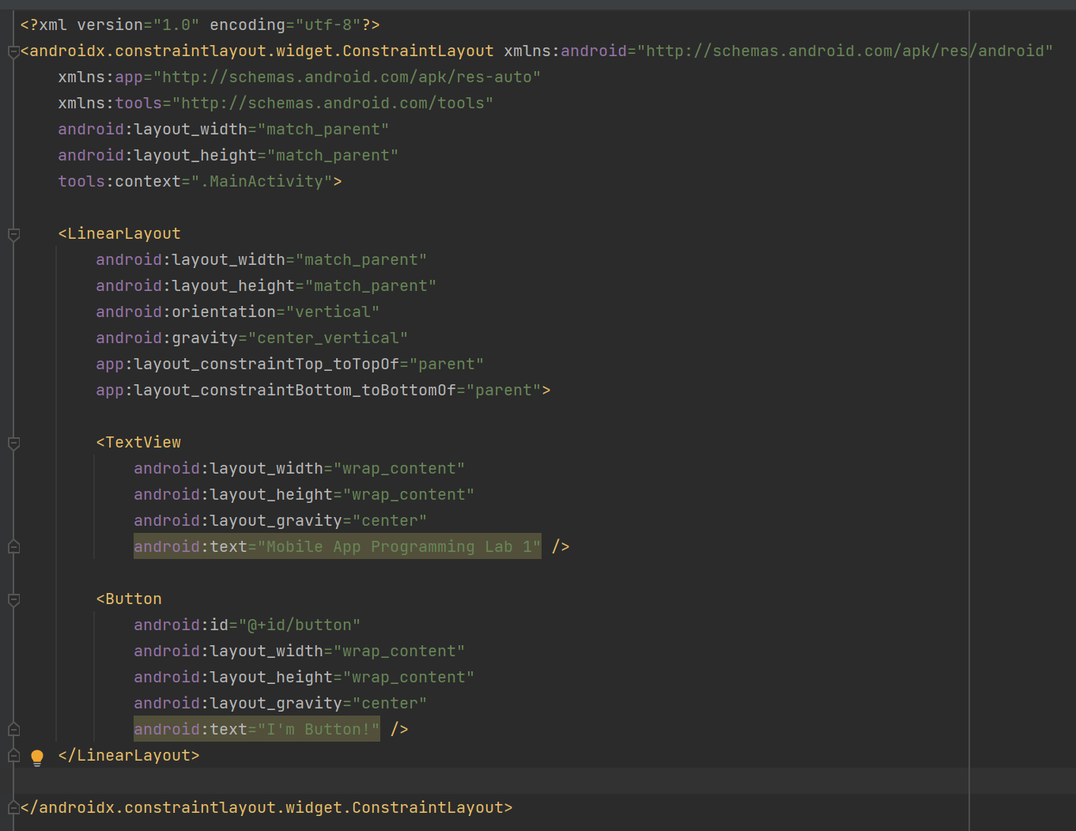
Put basic views into your project
* Modify the text of TextView and Button.

Slide 22
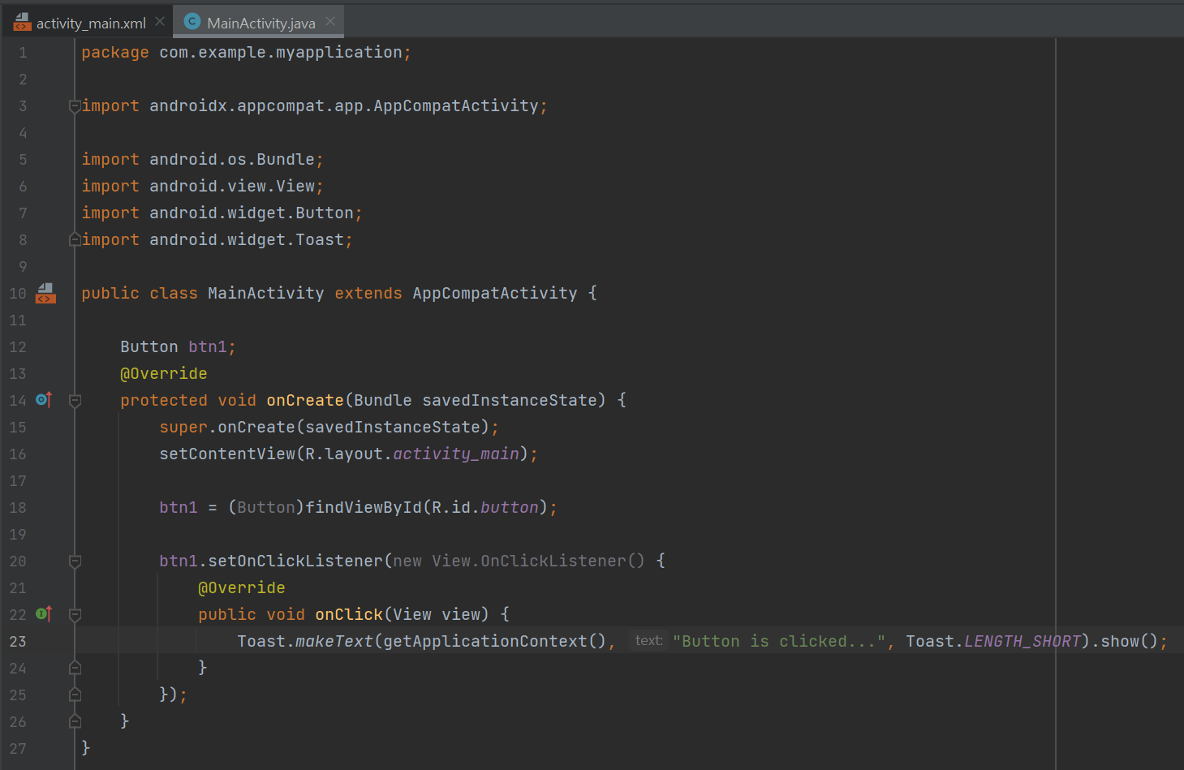
Put basic views into your project
4. Modify java activity file. Set button’s Click Listener.

Slide 23
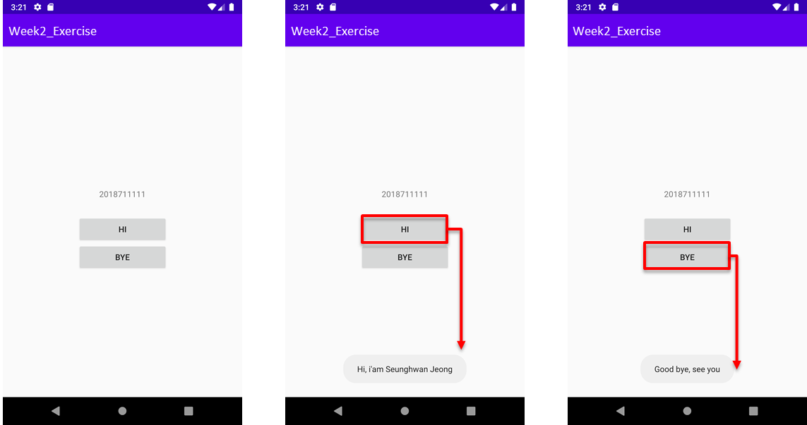
Exercise (submit to ICAMPUS)
Similar with example
Text attribute of text view is your name
If you click ‘HI’ button, toast “Hi, I am (your name)”
If you click ‘BYE’ button, toast “Good bye, see you again”
Submit your project code with “student_id.zip”
Other detail option is same with practice.
You don’t have to care about the size of buttons

